Slide 1
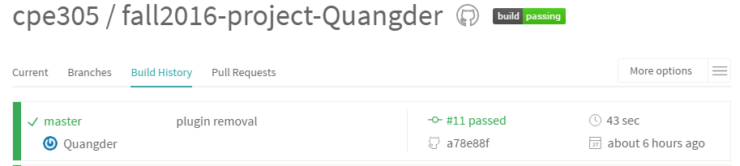
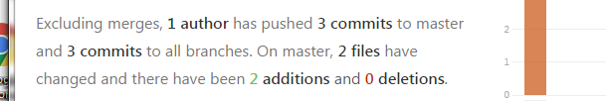
Virtual Assistant
Virtual Assistant will manage your schedule for you, so you can focus on getting things done.
Layered and Service Oriented Architecture
Services will interact with data layer
Allows the services to run in background
Analysing Data Layer

